Slide 1
SWOT Analysis
Strengths, Weaknesses, Opportunites and Threats
Taken from www.marketingteacher.com, accesed 17-11-2006, adapted for power point presentation. I'd included only some synonimus for Spanish learners.

Slide 2
SWOT Analysis
SWOT analysis is a tool for auditing an organization and its environment. It is the first stage of planning and helps marketers to focus on key issues.
SWOT stands for strengths, weaknesses, opportunities, and threats. Strengths and weaknesses are internal factors. Opportunities and threats are external factors.
* Issue: matter, factor

Slide 3
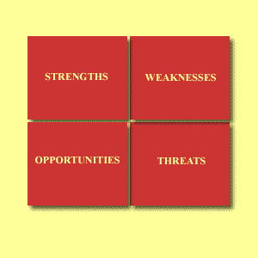
SWOT Analysis

Slide 4
SWOT Analysis
A strength could be:
Your specialist marketing expertise.
A new, innovative product or service.
Location of your business.
Quality processes and procedures.
Any other aspect of your business that adds value to your product or service.
Expertise: skill, ability, competence, expertness

Slide 5
SWOT Analysis
A weakness could be:
Lack of marketing expertise.
Undifferentiated products or services (i.e. in relation to your competitors).
Location of your business.
Poor quality goods or services.
Damaged reputation.
Lack: deficiency, shortage, scarcity
Damaged: injured

Slide 6
SWOT Analysis
An opportunity could be:
A developing market such as the Internet.
Mergers, joint ventures or strategic alliances.
Moving into new market segments that offer improved profits.
A new international market.
A market vacated by an ineffective competitor.
Merger: union

Slide 7
SWOT Analysis
A threat could be:
A new competitor in your home market.
Price wars with competitors.
A competitor has a new, innovative product or service.
Competitors have superior access to channels of distribution.
Taxation is introduced on your product or service.

Slide 8
SWOT Analysis
A word of caution:
SWOT analysis can be very subjective. Do not rely on SWOT too much.
Two people rarely come-up with the same final version of SWOT.
TOWS analysis is extremely similar. It simply looks at the negative factors first in order to turn them into positive factors. So use SWOT as guide and not a prescription.

Slide 9
SWOT Analysis
Simple rules for successful SWOT analysis.
Be realistic about the strengths and weaknesses of your organization when conducting SWOT analysis.
SWOT analysis should distinguish between where your organization is today, and where it could be in the future.
SWOT should always be specific. Avoid grey areas.
Always apply SWOT in relation to your competition i.e. better than or worse than your competition.
Keep your SWOT short and simple. Avoid complexity and over analysis
SWOT is subjective.

Slide 10
SWOT Analysis
SWOT can be used in conjunction with other tools for audit and analysis, such as PEST analysis and Porter's Five-Forces analysis.

